Slide 1

Malignant Comment Classification
By Jessica Ghimeliya

Slide 2
Introduction:-
Over a decade, social media have been growing, and people are able to express their opinions and also discuss among others via these platforms.
These debates may arise due to differences in opinion and may often result in fights over the social media during which offensive language termed as malignant comments may be used from one side.
This clearly pose the threat of abuse and harassment online.
As such, some people stop giving their opinions or give up seeking different opinions which result in unhealthy and biased discussion.
Therefore it results in different platforms and communities finding it very difficult to facilitate fair conversation and are often forced to either limit user comments or get dissolved by shutting down user comments completely.

Slide 3

Problem Statement:
The proliferation of social media enables people to express their opinions widely online. However, at the same time, this has resulted in the emergence of conflict and hate, making online environments uninviting for users. Although researchers have found that hate is a problem across multiple platforms, there is a lack of models for online hate detection.
Online hate, described as abusive language, aggression, cyber bullying, hatefulness and many others has been identified as a major threat on online social media platforms. Social media platforms are the most prominent grounds for such toxic behavior.
There has been a remarkable increase in the cases of cyber bullying and trolls on various social media platforms. Many celebrities and influences are facing backlashes from people and have to come across hateful and offensive comments. This can take a toll on anyone and affect them mentally leading to depression, mental illness, self-hatred and suicidal thoughts.
Internet comments are bastions of hatred and vitriol. While online anonymity has provided a new outlet for aggression and hate speech, machine learning can be used to fight it. The problem we sought to solve was the tagging of internet comments that are aggressive towards other users. This means that insults to third parties such as celebrities will be tagged as inoffensive, but “u are an idiot” is clearly offensive.
Our goal is to build a prototype of online hate and abuse comment classifier which can used to classify hate and offensive comments so that it can be controlled and restricted from spreading hatred and cyber bullying.

Slide 4
Abstract :-
The data set contains the training set, which has approximately 1,59,000 samples and the test set which contains nearly 1,53,000 samples. All the data samples contain 8 fields which includes ‘Id’, ‘Comments’, ‘Malignant’, ‘Highly malignant’, ‘Rude’, ‘Threat’, ‘Abuse’ and ‘Loathe’.
The label can be either 0 or 1, where 0 denotes a NO while 1 denotes a YES. There are various comments which have multiple labels. The first attribute is a unique ID associated with each comment.
The data set includes:
- Malignant: It is the Label column, which includes values 0 and 1, denoting if the comment is malignant or not.
- Highly Malignant: It denotes comments that are highly malignant and hurtful.
- Rude: It denotes comments that are very rude and offensive.
- Threat: It contains indication of the comments that are giving any threat to someone.
- Abuse: It is for comments that are abusive in nature.
- Loathe: It describes the comments which are hateful and loathing in nature.
- ID: It includes unique Ids associated with each comment text given.
- Comment text: This column contains the comments extracted from various social media platforms.

Slide 5
Steps to Follow:-
Loading Dataset
Pre-Processing
Data Analysis
Data Cleaning
Scaling
Model Building
Hyper-Parameter Tuning
Conclusion

Slide 6
Pre-Processing:-
1. Load dataset
2. Remove null values
3. Drop column id
4. Convert comment text to lower case and replace '\n' with single space.
5. Keep only text data i.e.. a-z and remove other data from comment text.
6. Remove stop words and punctuations
7. Apply Stemming using Snowball Stemmer
8. Convert text to vectors using TfidfVectorizer
9. Load saved or serialized model
10. Predict values for multi class label

Slide 7
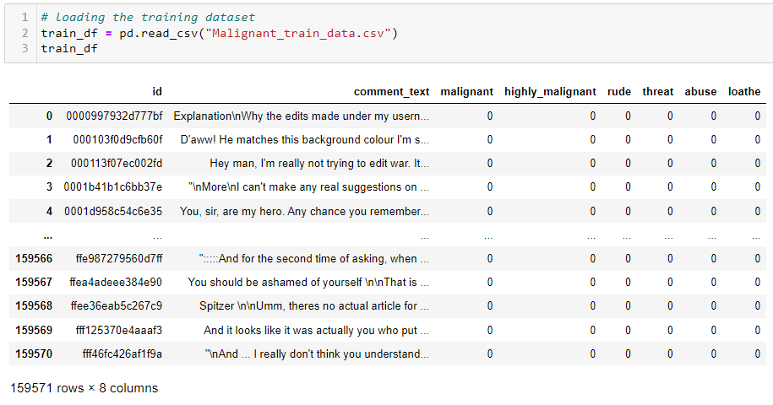
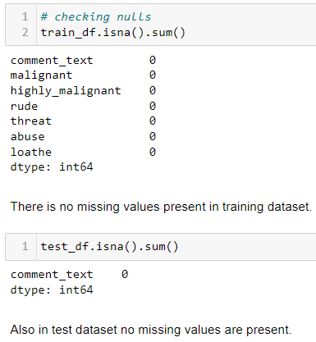
Loading Dataset:-
Missing Values:

Slide 8
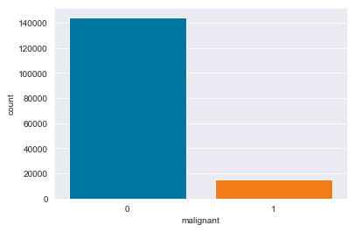
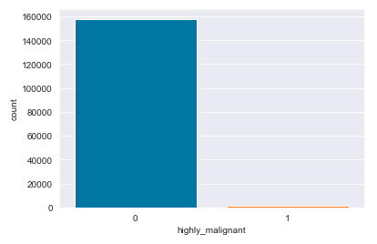
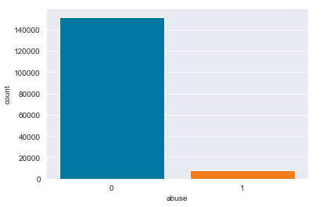
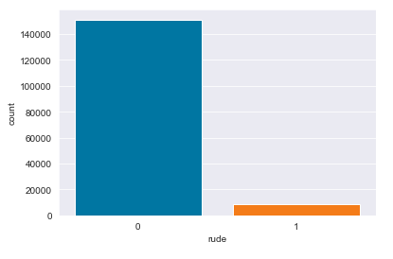
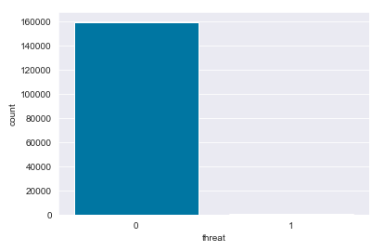
Count Plots:-

Slide 9
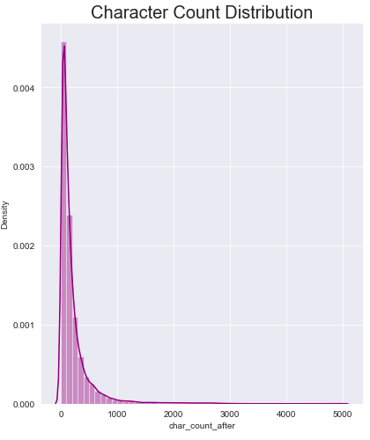
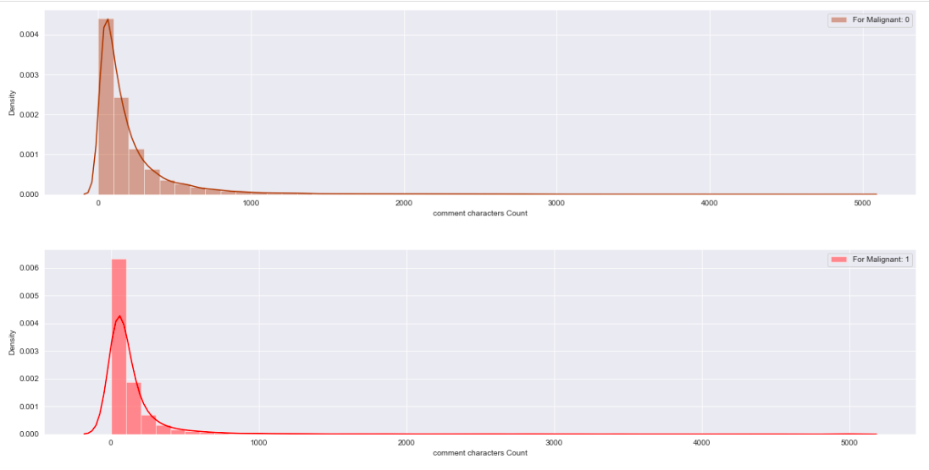
Distribution Plots:-

Slide 10
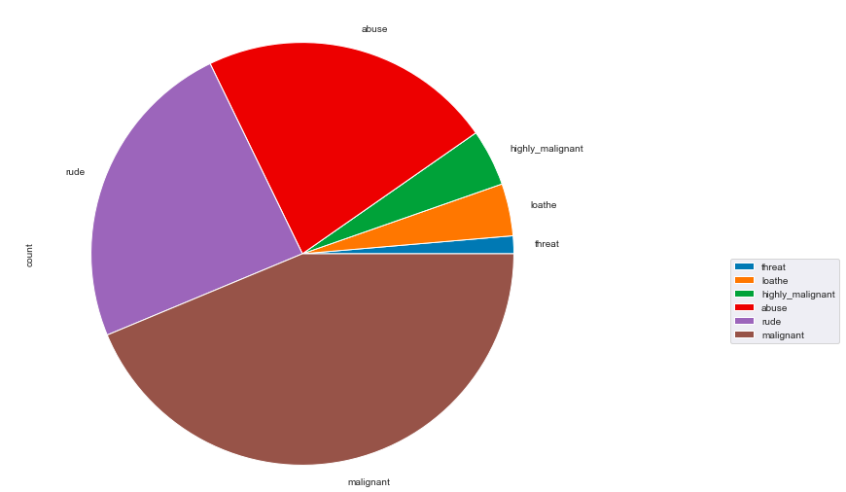
Pie Plot:-

Slide 11
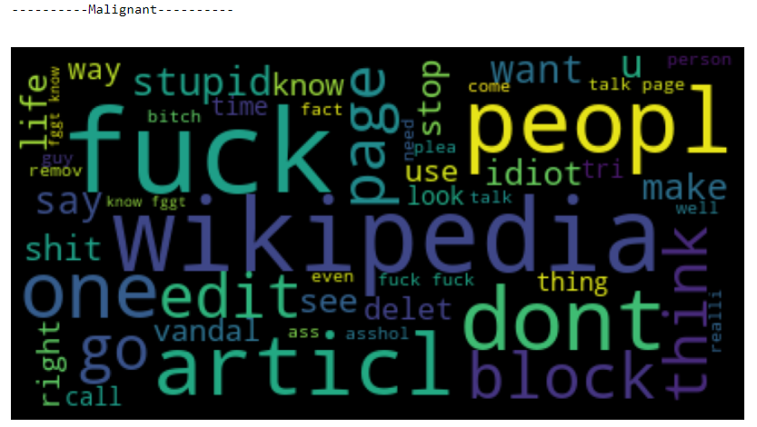
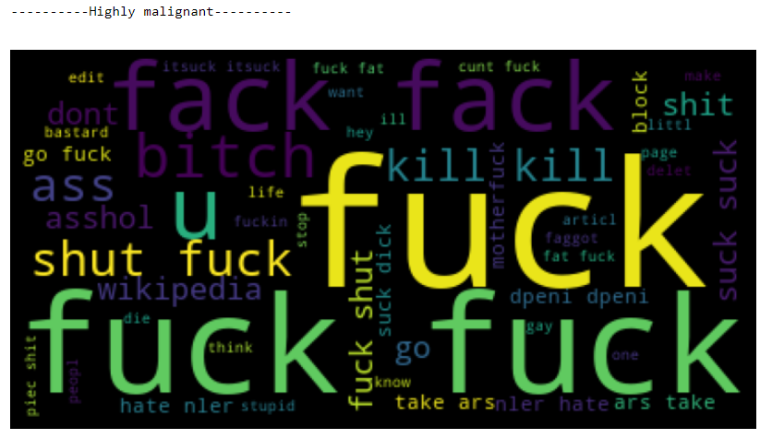
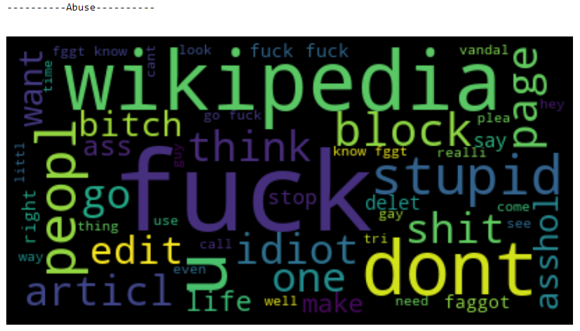
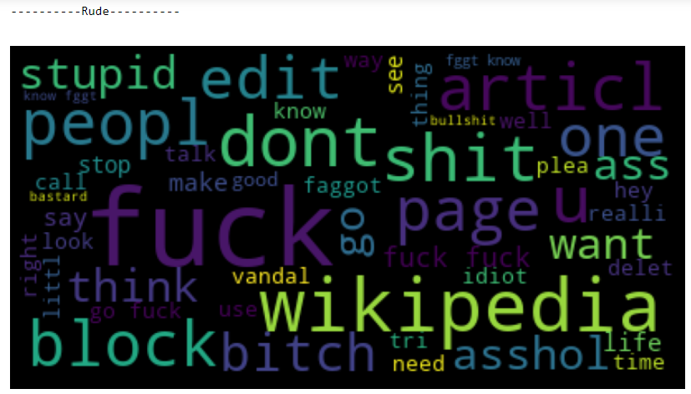
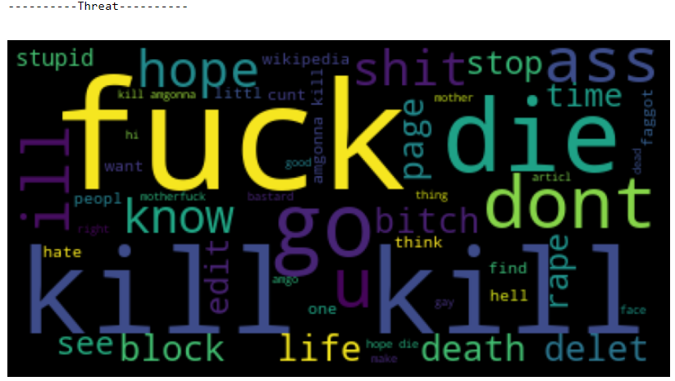
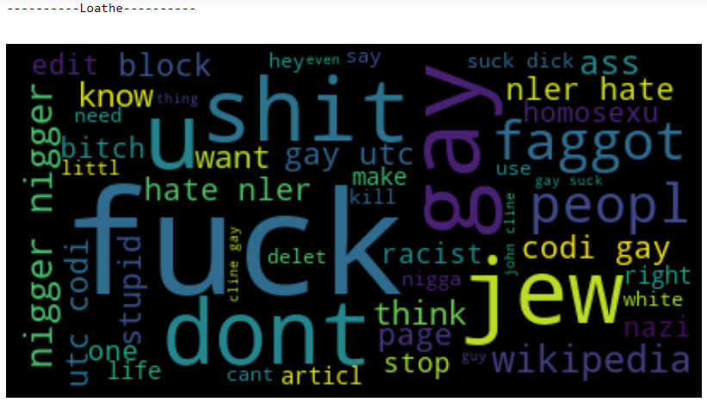
Word Cloud:-

Slide 12
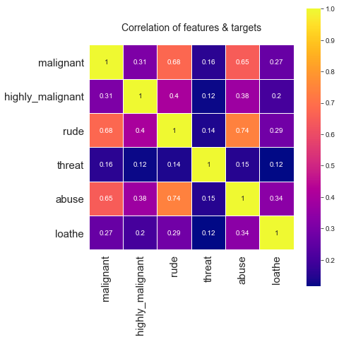
Heat Map:-

Slide 13
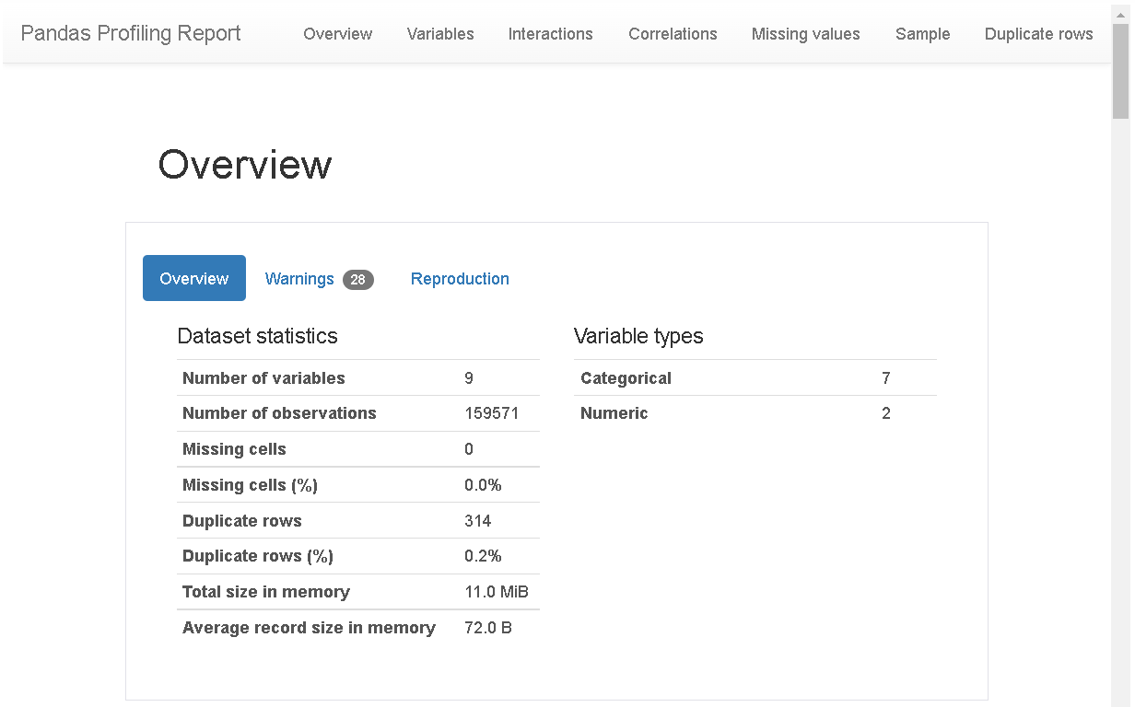
Pandas Profiling:-:-

Slide 14
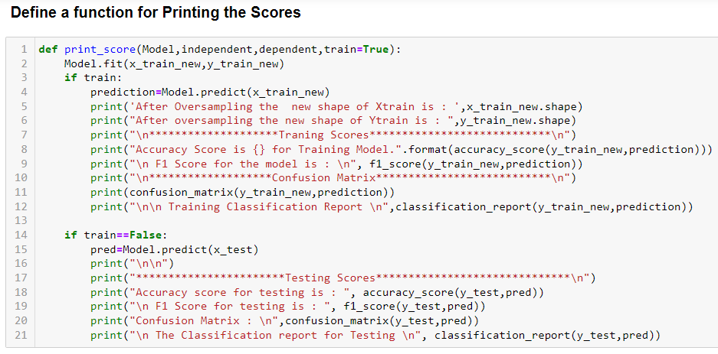
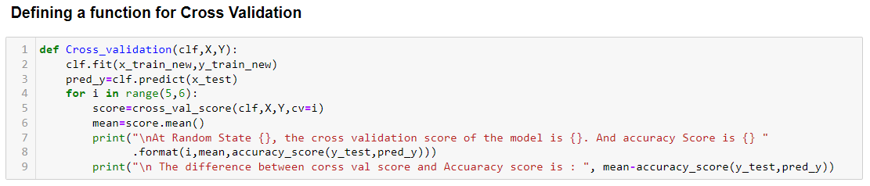
Customized Define Classification Functions:-

Slide 15
All Model’s Scores:-
Model's Name | Testing Accuracy Score | F1 Score | Cross Validation Score | Differnce
Logistic Regression | 91.59% | 67.03% | 95.61% | 4.02
DecisionTree Classifier | 91.59% | 62.93% | 93.89% | 2.29
Random Forest Classifier | 94.51% | 72.56% | 95.47% | 0.96
AdaBoostClassifier | 93.55% | 66.97% | 94.78% | 1.23
GradientBoostingClassifier | 94.18% | 68.52% | 94.24% | 0.056
ExtraTreesClassifier | 95.02% | 73.39% | 95.48% | 0.45
SVC | 94.83% | 65.18% | 95.70% | 0.87
SGDC Classifier | 89.88% | 62.62% | 94.90% | 5.02
Multinomial NB | 92.08% | 67.77% | 94.68% | 2.60

Slide 16
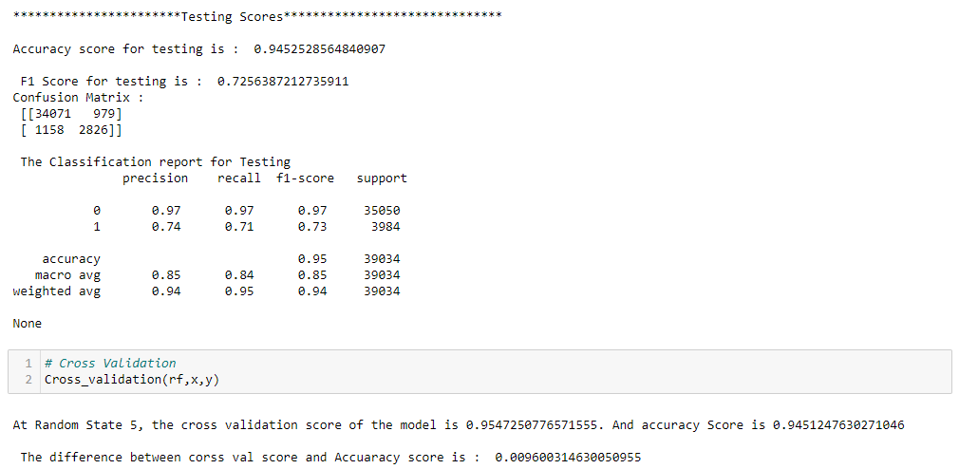
Printing Random Forest Scores:-

Slide 17
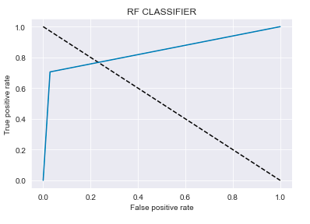
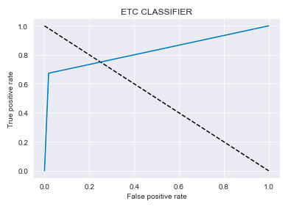
ROC AUC Curve For Random Forest:-
ROC AUC Curve For Extra Trees Classifier:-

Slide 18
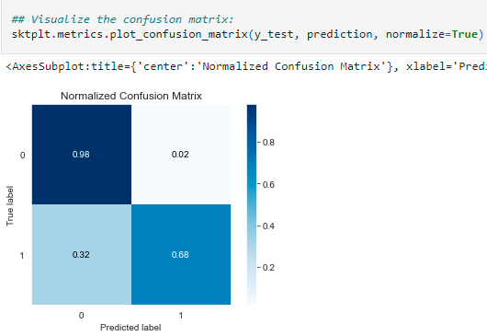
Correlation Matrix:-

Slide 19
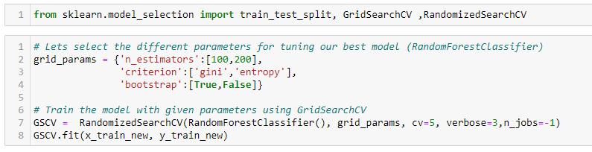
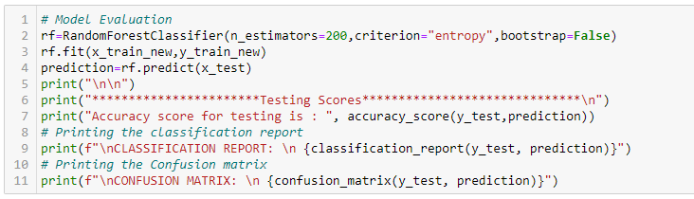
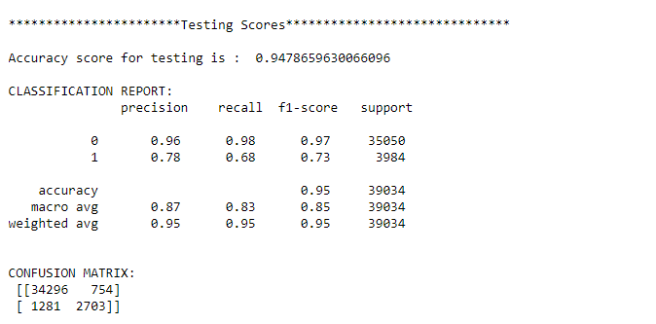
Hyper-Parameter Tuning:-

Slide 20
Key Findings and Conclusions of the Study
The survey discovered that just a small percentage of online users use unparliamentarily language.
And the majority of these phrases contain a lot of stop words and are pretty lengthy.
As previously said, a few motivated rude mobs use harsh language in internet forums to harass individuals and prevent them from doing what they are not permitted to do.
Our research aids online forums and social media in enforcing a prohibition on swearing or the use of profanity on these platforms.

Slide 21
Conclusion:-
Problems faced while working in this project:
More computational power was required as it took more than 2 hours
Imbalanced dataset and bad comment texts
Good parameters could not be obtained using hyper parameter tuning as time was consumed more
Areas of improvement:
Could be provided with a good dataset which does not take more time.
Less time complexity
Providing a proper balanced dataset with less errors.

Slide 22
Thank
You…!!!

